Slide 1
Chapter 3
Bitcoin Core: The Reference
Implementation
Course Notes
CSE0469 Blockchain: Special Topics in SW Engineering
Yusuf Altunel
Based on Mastering Bitcoin 2e; Andreas M. Antonopoulos; O’Reilly, 2017

Slide 2

Content
Bitcoin Development Environment
Running a Bitcoin Core Node
Bitcoin Core Application Programming Interface (API)
Alternative Clients, Libraries, and Toolkits
Windows Installation

Slide 3
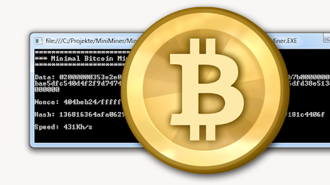
Bitcoin: an open source project
Bitcoin Project
free to download
the source code licensed
free to use
Open source
Usage
Free for any purpose
License
Under open(MIT) license

Slide 4
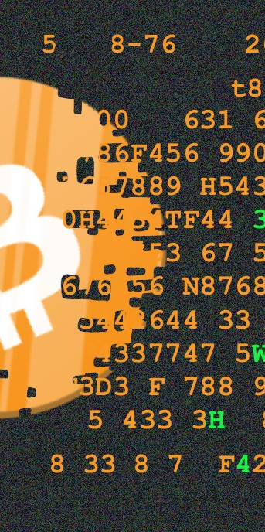
Bitcoin: an open source project
Community
bitcoin is developed by an open community
Full-time Developers
a dozen developers
several dozen more on a part-time basis.
working on the code almost full-time
Part-time Developers

Slide 5
Bitcoin: an open source project
Contribution to activities
Anyone can contribute to the code
Statistics
By 2016: more than 400 contributors
To the source code of Bitcoin core
Check https://bitcoincore.org/en/contribute/
Who can Contribute?
Improve documentation
Translations
Participating to mailing lists
Improving User Interface
Coding
Contribution to development
Testing

Slide 6

Satoshi Client
Famous paper
known as “Bitcoin” or “Satoshi client”
Improvements
1st version of Bitcoin implementation
«Bitcoin: A Peer-to-Peer Electronic Cash System»
“Satoshi client”
Implemented
Satoshi client has been heavily modified and improved
before the white paper

Slide 7

Bitcoin Core
«Client» to «Core»
the authoritative reference
Satoshi client evolved into Bitcoin Core
Bitcoin core
Aim
show how each part of the technology
to be implemented

Slide 8
Bitcoin Core Features
wallets
engine
a full network node
transaction validation
block validation
Network node
the peer-to-peer bitcoin network
storing Bitcoin
transacting in Bitcoin

Slide 9
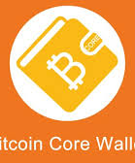
Wallet in Bitcoin Core
Bitcoin Core Wallet
Actual Wallet
A modern standard for walled implementations
Not for use
for real users or applications!
Implementation is included
just as a reference implementation
not intended to be used
Advised to use BIP 39/32

Slide 10

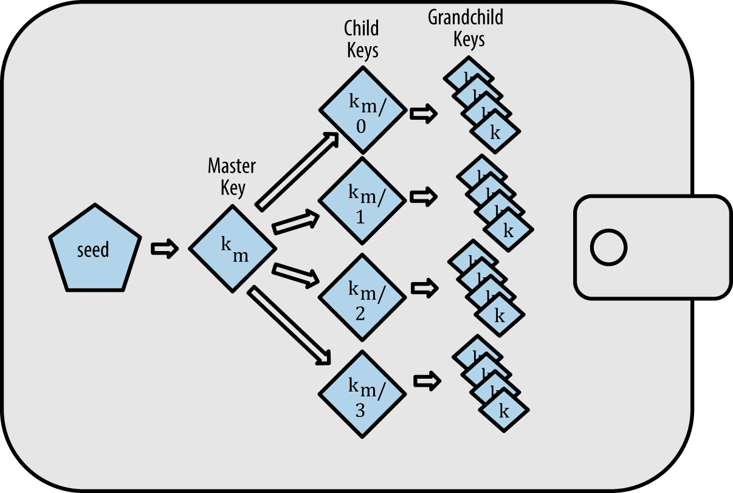
Wallet in Bitcoin Core
BIP
stands for
Bitcoin Improvement Proposal.
BIP-32
HD
multiple addresses for a Bitcoin
derived from a single seed
hierarchical deterministic wallet
Features

Slide 11
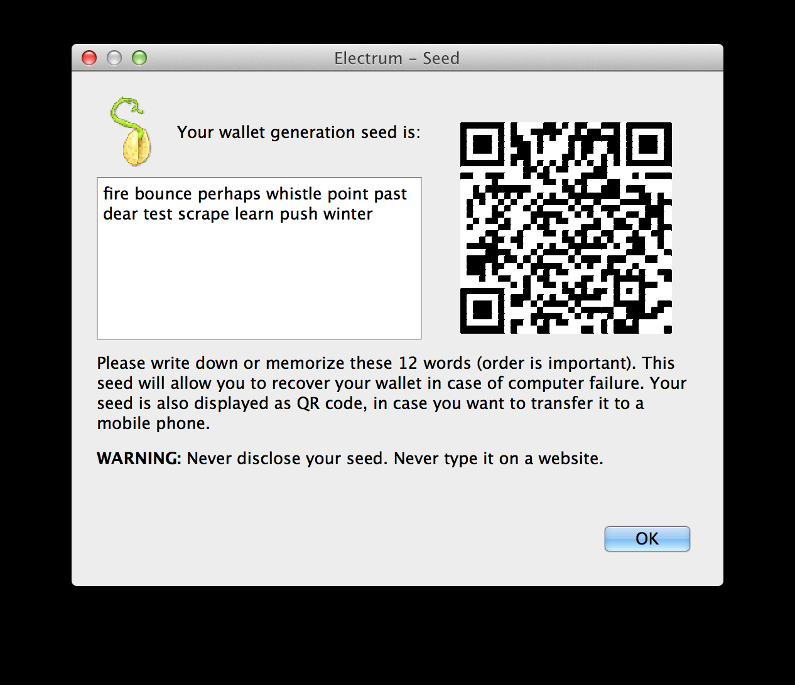
Wallet in Bitcoin Core
BIP-39
to manage recovery seed
a mnemonic code
Mnemonic is used
and recovery words
Mnemonic
or mnemonic sentence
Usage
to generate and recover keys

Slide 12
Bitcoin Developmen Environment
Developers
Set up dev environment
Environment
all the tools
libraries
support software

Slide 13
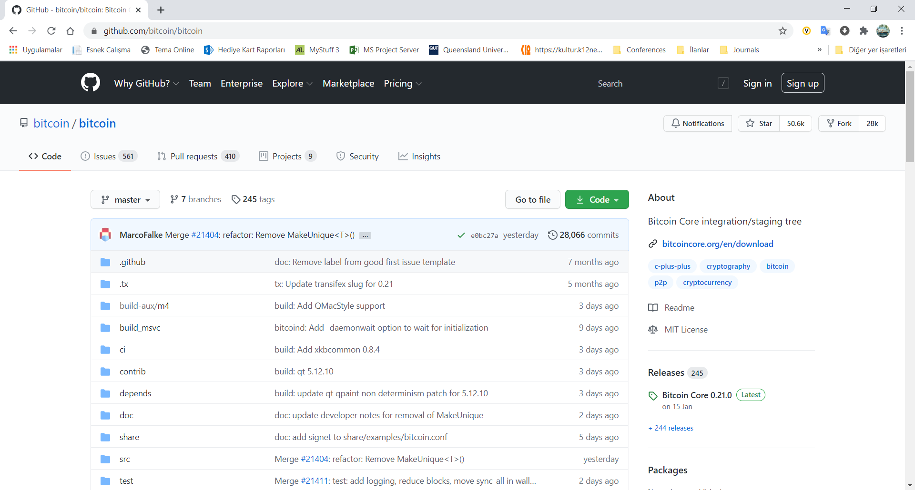
Download Bitcoin Core’s Source Code
Download
as a ZIP archive On the GitHub Bitcoin Page
select Download ZIP https://github.com/bitcoin/bitcoin
Create local copy of source code
Use git Command line
$ git clone https://github.com/bitcoin/bitcoin.git
Git
Distributed version control system
You need to install Git if you don’t have it
Local copy
Notice!

Slide 14
Selecting a Bitcoin Core Release
Synchronization
By default, the local copy will be synchronized
Synchronize before compile
Before compiling the code,
This will synchronize
Tags
used by the developers
with a specific snapshot
identified by a keyword tag.
by version number.
with the most recent code
select a specific version
by checking out a release tag.
the local copy
of the code repository
to mark specific releases of the code

Slide 15
Running a Bitcoin Core Node
Node
Bitcoin’s peer-to-peer network
authoritative view
composed of network “nodes,”
a direct and authoritative view
a local copy of
independently validated by their own system.
of the bitcoin blockchain
Transactions
all the transactions
Independent validation

Slide 16
Running a Bitcoin Core Node
build bitcoin applications
Independence
No need to rely on third party
contribute to the bitcoin network
by making it more robust.
voluteers
run mostly by volunteers
Business
to validate a transaction.
conribution

Slide 17
Resources
Full stack node
Connection
Resources
index all transactions
Full copy
starting from 2009
keep a full copy of the blockchain
to process transactions
a permanently connected system

Slide 18
Minimum Requirements
Configuration
2 GB RAM
one-time download of about 400GB of data
plus a further 5-10GB per month
Desktop
Laptop
ARM chipsets>1GHz
Operating Systems
Desktop or laptop hardware
running recent versions of OS
100 MB/s read/write speed
System
Operating Systems
MS Windows
Mac OS X
Linux
https://bitcoin.org/en/full-node#minimum-requirements

Slide 19
Various Solutions
Raspberry Pi
a $35 USD computer the size of a pack of cards)
VPS-Virtual Private Server
Cost
can be rented
run bitcoin nodes on
rented servers
usually some variant of Linux.
for $25 to $50 USD per month.

Slide 20
Reasons to Run a Node
Development
Transaction Validation
building applications
access to the network and blockchain.
on a bitcoin node
for programmable (API)
Access to Bitcoin
to validate transactions

Slide 21

Reasons to Run a Node
Support Bitcoin
Running a node
Security
to not rely on any third party
more wallets
to process or validate own transactions
makes the network more robust
Serve
more users
more transactions

Slide 22
Running Bitcoin Core for the First Time
Run bitcoind
typing bitcoind into the terminal
Configuration file
tells what is needed
Notice
it is recommended
to build a configuration file
you to set up the alerting mechanism.

Slide 23
Configuring the Bitcoin Core Node
Configuration
replace the password
Notice
Do not use the password
bitcoin.conf
Create a file inside the .bitcoin directory
under your user’s home directory
Account
rpcuser=bitcoinrpc
rpcpassword=CHANGE_THIS
Edit the configuration file
provide a username and password:
in preferred editor
set the parameters,
Pasword
with a strong password
as recommended by bitcoind
shown in the book.
named .bitcoin/bitcoin.conf

Slide 24
Other Configurations
options
Bitcoin Core offers
What can be modified?
behavior of the network node
the storage of the blockchain
many other aspects of its operation
To see a listing of these options,
run bitcoind --help:
more than 100 configuration options

Slide 25
most important options
alertnotify
to send emergency alerts
conf
An alternative location
to the owner of this node
usually by email
for the configuration file

Slide 26
most important options
datadir
Select the directory and filesystem
this is the .bitcoin subdirectory
Make sure this filesystem
to put all the blockchain data.
Default
of your home directory.
Space
has several gigabytes of free space.

Slide 27
most important options
prune
Reduce the disk space requirements
Usage
by deleting old blocks
if the full blockchain
cannot fit to the disk space
Old Blocks

Slide 28
most important options
txindex
Maintain an index of all transactions
means
a complete copy of the blockchain
allows
any transaction by ID
to programmatically retrieve

Slide 29
most important options
maxconnections
maximum number of nodes
Bandwith
if there is a data cap
to accept connections
Useful
or pay by the gigabyte
reduce bandwidth consumption.

Slide 30
most important options
maxmempool
Limit the transaction memory pool
Use it
maxreceivebuffer/maxsendbuffer
Limit per-connection memory buffer
Use
to so many megabytes.
to reduce memory use of the node.
to so many multiples of 1000 bytes.
on memory-constrained nodes

Slide 31
most important options
minrelaytxfee
Set the minimum fee transaction
Use
Below this value
the transaction is treated as zero fee.
you will relay
to reduce the size of
the in-memory transaction pool.

Slide 32
Bitcoin Core’s Programmatic Interface
Interface
Bitcoin Core’s API is
RPC
Remote Procedure Call
calling remote procedures or functions
the network protocol is HTTP
HTTP
HTTPS
a JSON-RPC interface.
the Bitcoin Core node
via a network protocol
Connection
for encrypted connections

Slide 33
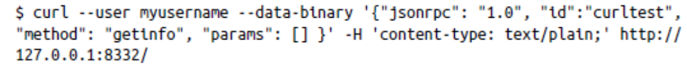
Bitcoin Core’s Programmatic Interface
curl
command-line HTTP client
to construct one of these JSON-RPC calls
The command
connecting to the default bitcoin port
submitting a jsonrpc request
curl submits an HTTP request
for the getinfo method
using text/plain encoding
Default port
to the local host
127.0.0.1
8332

Slide 34
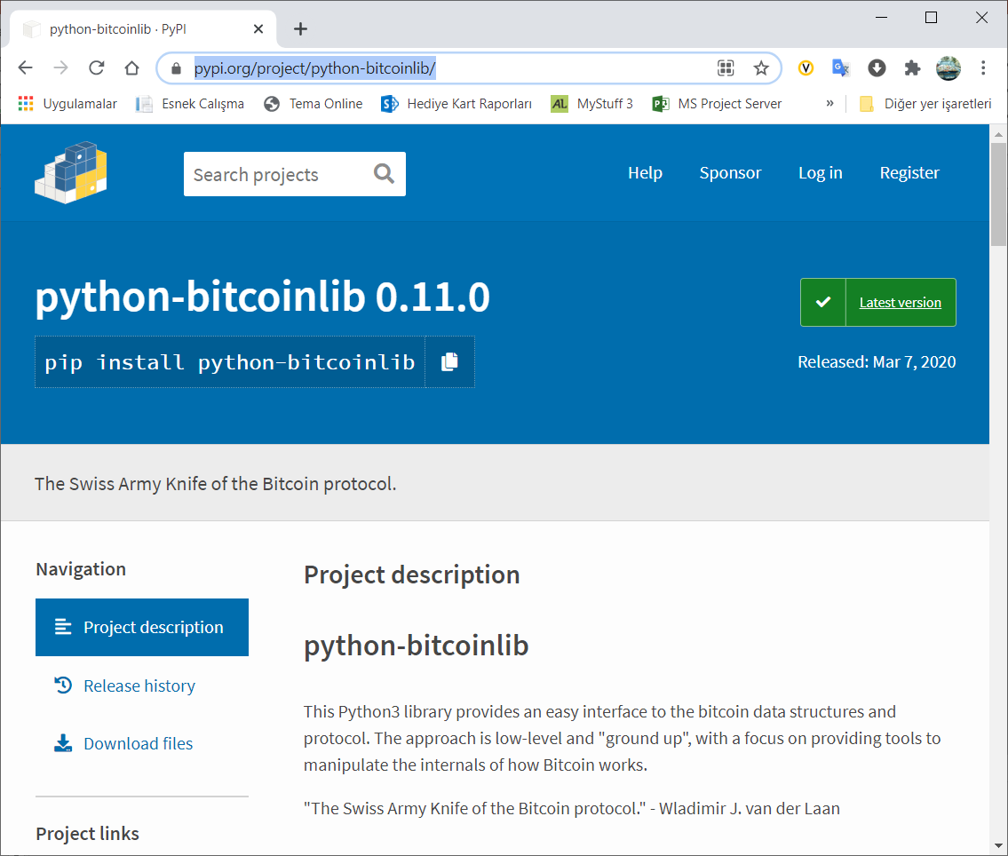
Pythonbitcoinlib library
Libraries
provides an easy interface
examples/ directory
chain to use
import bitcoin
Example Code
to the bitcoin data structures and protocol
bitcoin.SelectParams(NAME)
NAME
'testnet’
'mainnet’
'regtest'
https://pypi.org/project/python-bitcoinlib/
Download: https://pypi.org/project/python-bitcoinlib/#files

Slide 35
Alternative Clients, Libraries, and Toolkits
Bitcoin Core
The reference implementation of bitcoin
libbitcoin
Cross-platform C++ development toolkit, node, and consensus library
bitcoin explorer
Libbitcoin’s command-line tool
picocoin
A C language lightweight client library for bitcoin by Jeff Garzik
C/C++

Slide 36
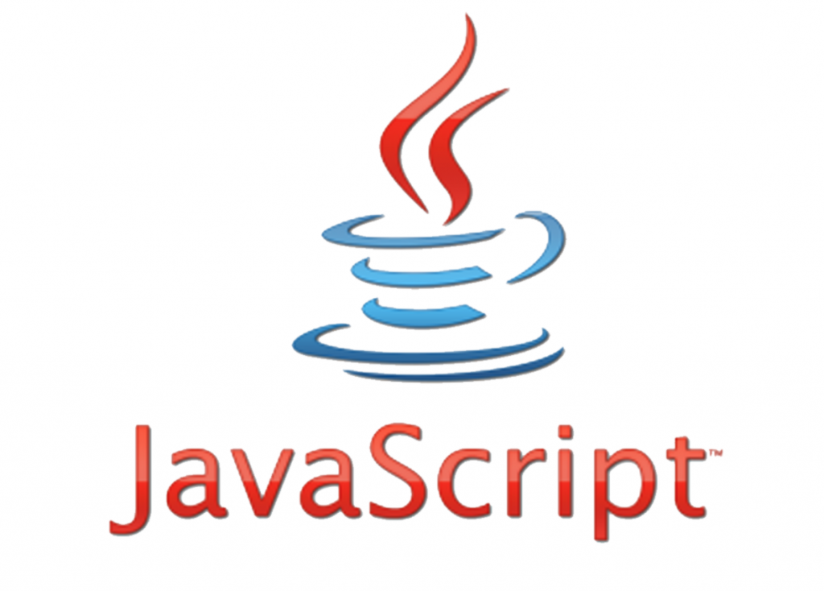
JavaScript
bcoin
A modular and scalable full-node implementation with API
Bitcore
Full node, API, and library by Bitpay
BitcoinJS
A pure JavaScript Bitcoin library for node.js and browsers

Slide 37
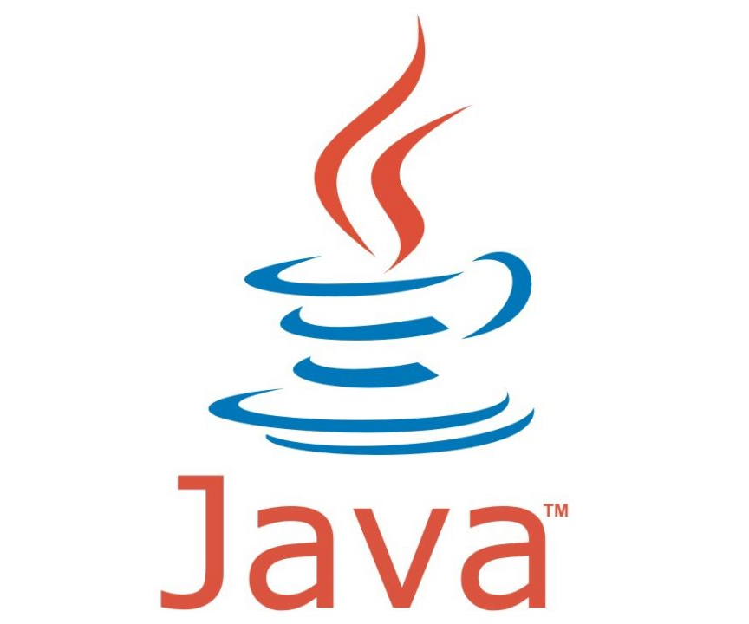
Java
bitcoinj
A Java full-node client library
web3j
Lightwieght Java & Android Library
For integration with Etherium clients
Notice: Not available in the book!
fabric-sdk-java
a backbone for developing blockchain solutions
under development from the Linux Foundation members
Notice: Not available in the book!
Bits of Proof (BOP)
A Java enterprise-class implementation of bitcoin
Notice: Not a valid library anymore!

Slide 38

Python
python-bitcoinlib
A Python bitcoin library, consensus library, and node by Peter Todd
pycoin
A Python bitcoin library by Richard Kiss
pybitcointools
A Python bitcoin library by Vitalik Buterin
Notice: This library is not maintained anymore!

Slide 39

Ruby, Go, and Rust
Ruby
bitcoin-client
A Ruby library wrapper for the JSON-RPC API
Go
btcd
A Go language full-node bitcoin client
Rust
rust-bitcoin
Rust bitcoin library for serialization, parsing, and API calls

Slide 40


C# & Objective-C
C#
NBitcoin
Comprehensive bitcoin library for the .NET framework
Objective-C
CoreBitcoin
Bitcoin toolkit for ObjC and Swift

Slide 41
Instructions for Windows
Download
Go to the Bitcoin Core Download Page
Click the Download Bitcoin Core
Run installer
run downloaded installer file
Windows will ask you to confirm that you want to run it.
Click Yes and the Bitcoin installer will start.
Typical Windows installer
It’s a typical Windows installer,
it will guide you through the decisions you need to make about where to install Bitcoin Core.

Slide 42
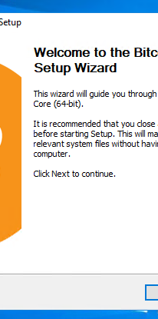
Options
Core GUI
If you want to use the Bitcoin Core Graphical User Interface (GUI)
proceed to the Bitcoin Core GUI section below.
Bitcoin Core daemon
useful for programmers and advanced users
bitcoind: use the Bitcoin Core daemon
Both
you can’t run both the GUI and the daemon at the same time
using the same configuration directory

Slide 43
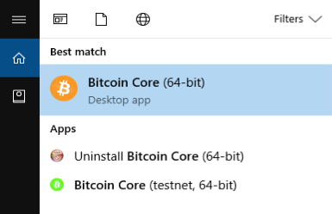
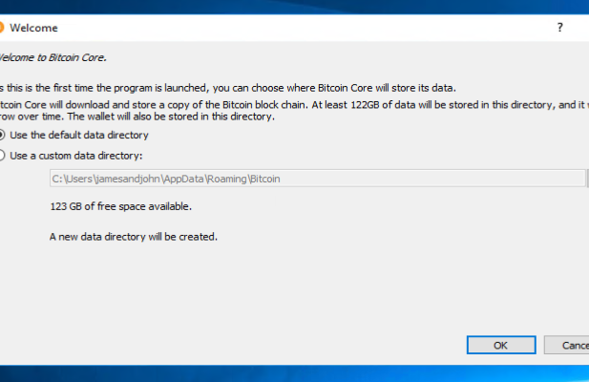
Bitcoin Core GUI
Install
Press Windows key (⊞ Win)
start typing “bitcoin”.
When the Bitcoin Core icon appears click on it.
Chose a directory
to store the Bitcoin block chain and your wallet.
Unless you have a separate partition or drive you want to use,
click Ok to use the default.
Firewall setting
Your firewall may block Bitcoin Core from making outbound connections.
It’s safe to allow Bitcoin Core to use all networks.

Slide 44
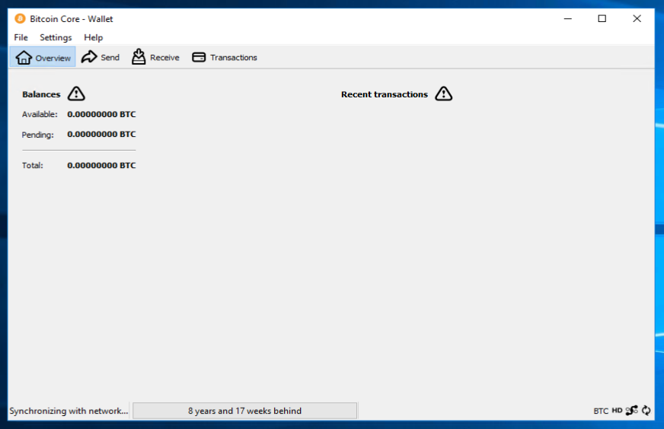
download the block chain
Block Chain Download
Bitcoin Core GUI will begin to download the block chain
takes at least several days
Consume CPU, Memery and Internet connection
Start/Stop
You can stop Bitcoin Core
it will resume
at any time by closing it
from the point where it stopped
the next time you start it.

Slide 45
Final Steps
Start to use
use Bitcoin Core as wallet
or just let it run
Automatic start
Optional:
Starting automatically
to help support the Bitcoin network
Start Your Node At Login
at login
makes it easy to contribute to the network.

Slide 46
Final Steps
Setting up Automatic Start
1
tell Bitcoin Core GUI to start at login.
While running Bitcoin Core GUI
open the Settings menu and choose Options.
On the Main tab,
Click the Ok button
Setup
2
Main tab
3
click Start Bitcoin on system login.
OK
4
to save the new settings

Slide 47



Discussions
Asses what you got so far!
Noticible issues
Interesting Details
Unclarified issues
What do you think on this chapter?
Do you think the bitcoin inspiring?
What is the most interesting point?
Select and explain a critical issu in this chapter
What are the points need further explanations?

Slide 48
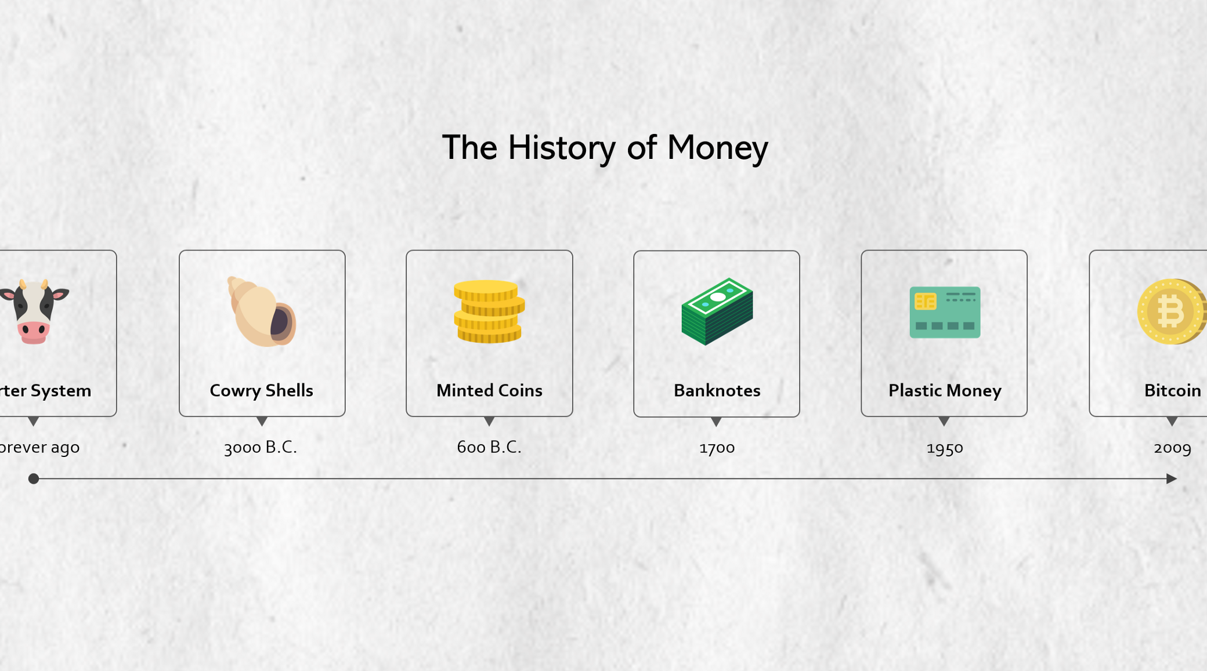





Thank You
y.altunel@iku.edu.tr
Yusuf Altunel, PhD
https://www.linkedin.com/in/yusuf-altunel-2070a31b/
https://cats.iku.edu.tr/portal/site/cd88fc16-3584-46f0-a539-890caf466d53

